Slide 1
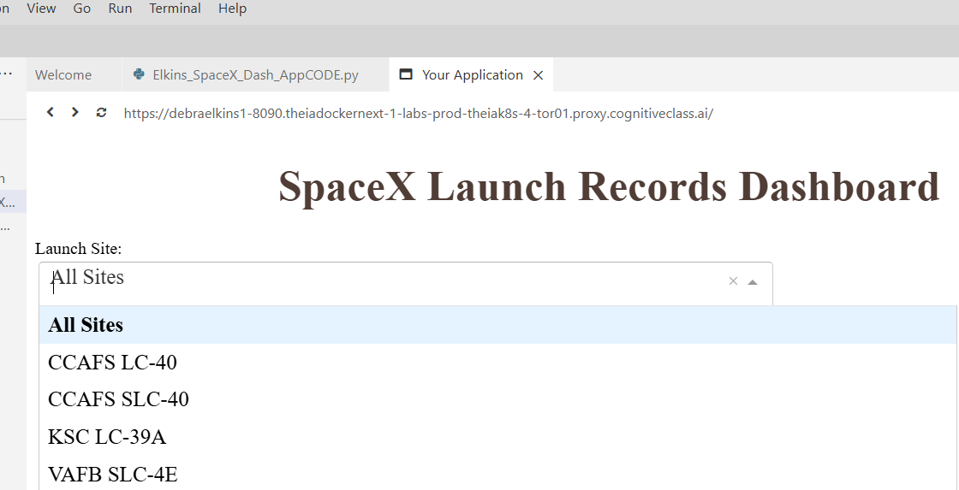
Debra Elkins
Build an Interactive Dashboard with Plotly & Dash
TASK 1: Add a Launch Site Drop-down Input Component

Slide 2
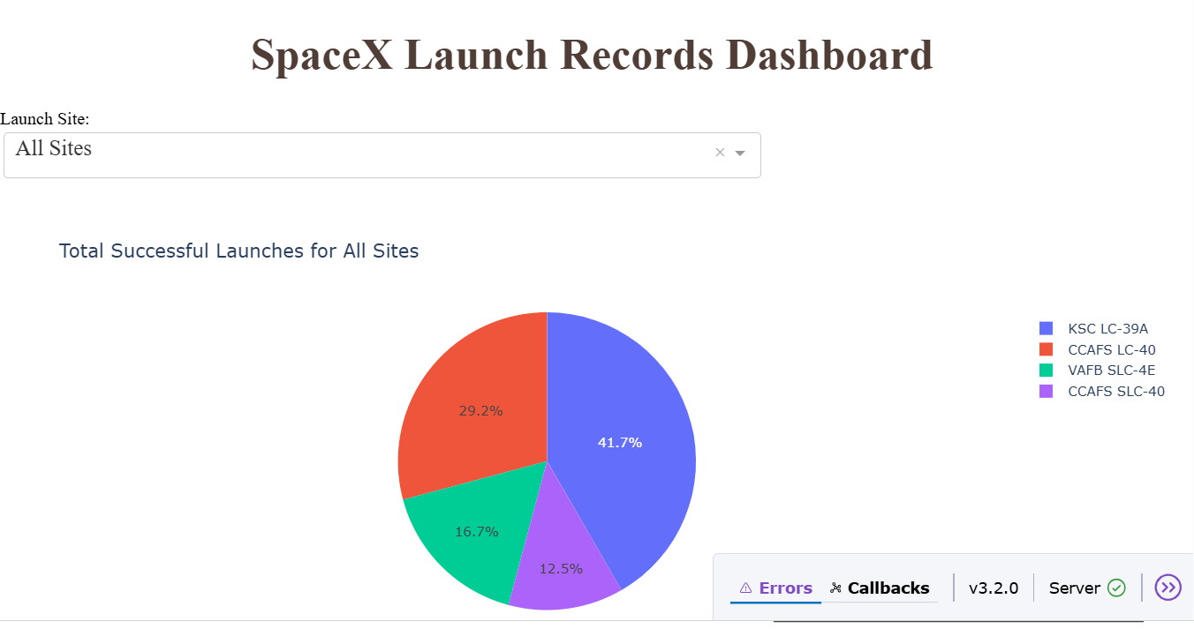
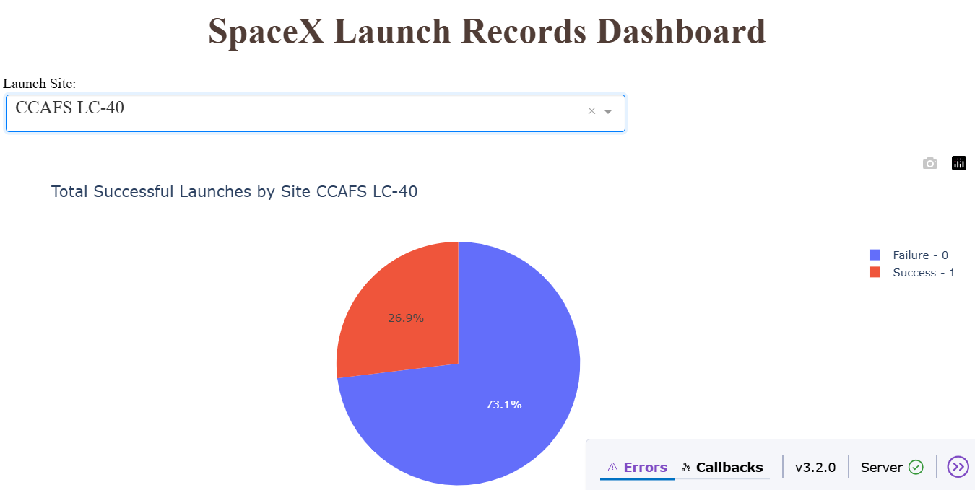
Debra Elkins
Build an Interactive Dashboard with Plotly & Dash
TASK 2: Add a callback function to render success-pie-chart based on selected site dropdown

Slide 3
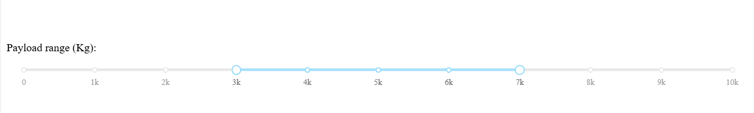
Debra Elkins
Build an Interactive Dashboard with Plotly & Dash
TASK 3: Add a Range Slider to Select Payload

Slide 4
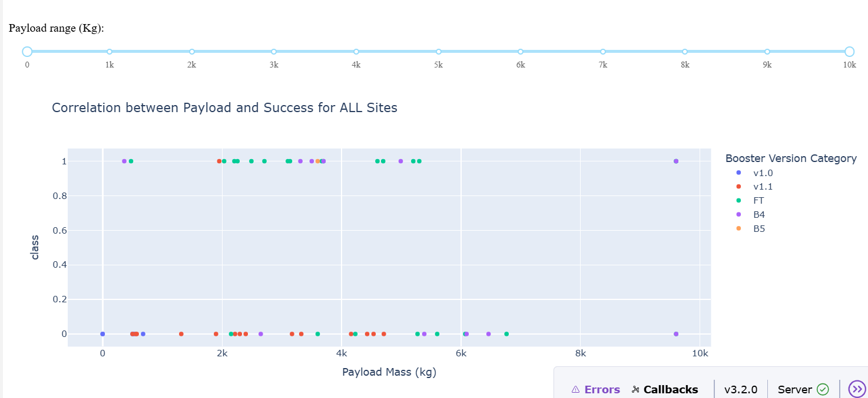
Debra Elkins
Build an Interactive Dashboard with Plotly & Dash
TASK 4: Add a callback function to render the success-payload-scatter-chart scatter plot

Slide 5
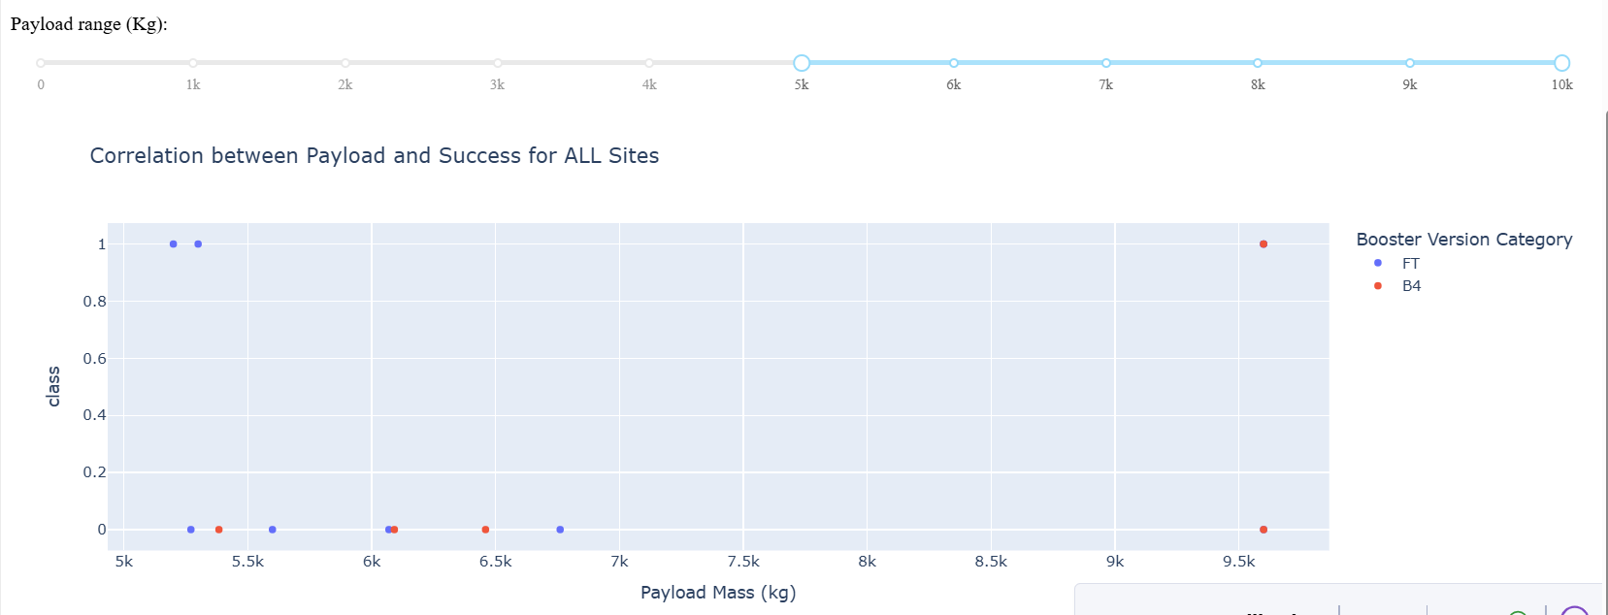
Debra Elkins
Visual Analysis using Plotly & Dash
Which site has the largest successful launches?
ANSWER:
VAFB SLC-4E has the 3 successful “largest” launches with payloads of 5200 kg, 5300 kg and 9600 kg

Slide 6
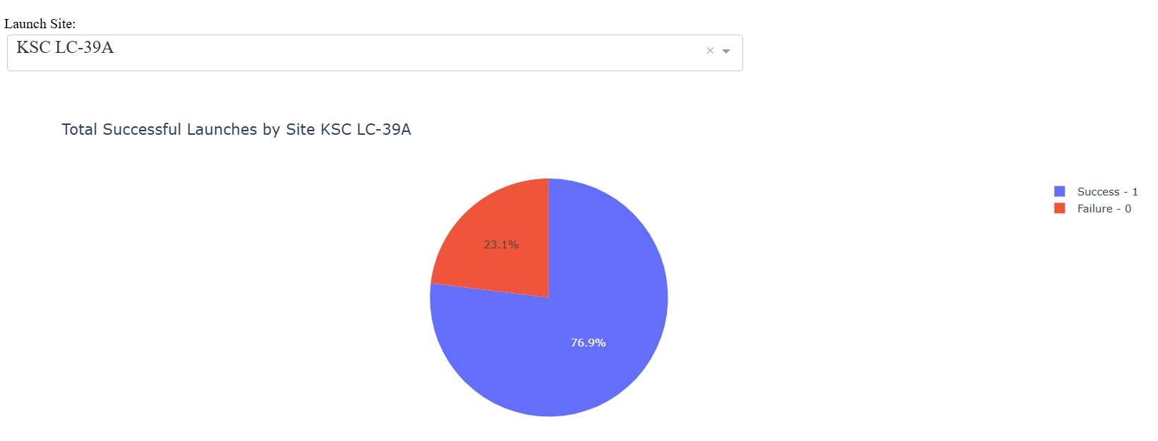
Debra Elkins
Visual Analysis using Plotly & Dash
2. Which site has the highest launch success rate?
ANSWER:
KSC LC-39A has the highest launch success rate with 10 out of 13 launches = 76.9%

Slide 7
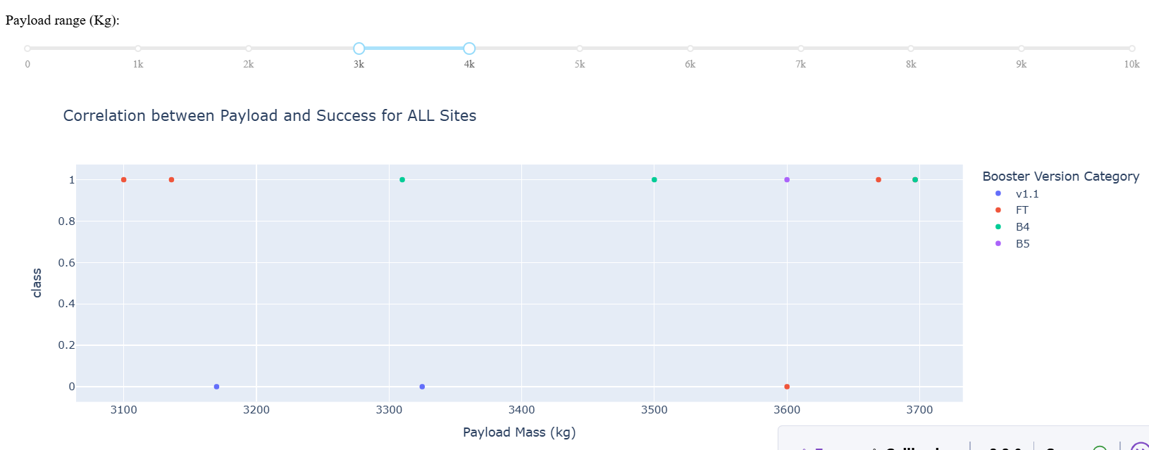
Debra Elkins
Visual Analysis using Plotly & Dash
3. Which payload range(s) has the highest launch success rate?
ANSWER:
3000 kg to 4000 kg yields
7 successful launches to 3 failed launches = 7/10 = 70% success rate

Slide 8
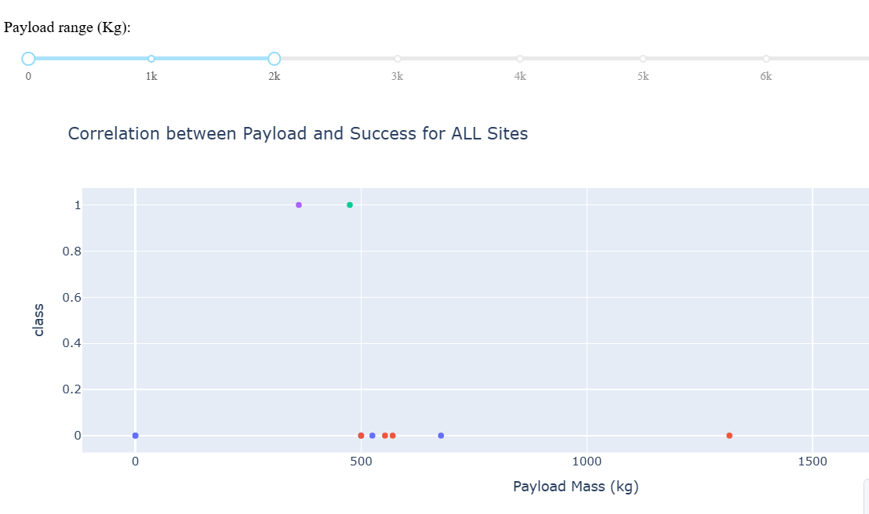
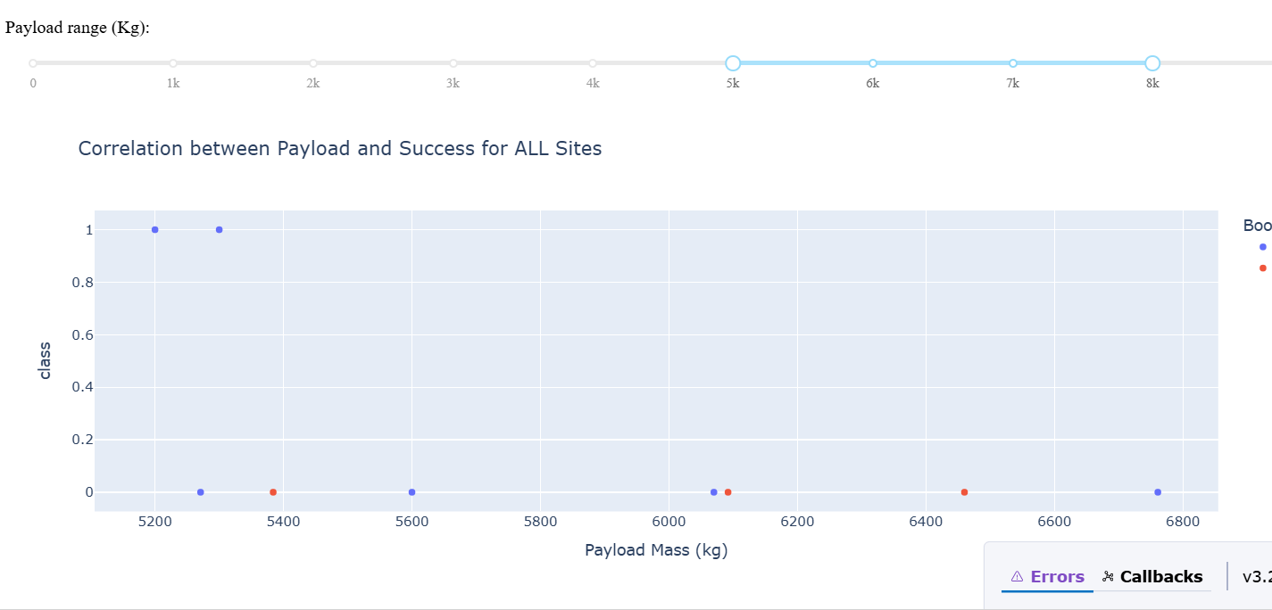
Debra Elkins
Visual Analysis using Plotly & Dash
4. Which payload range(s) has the lowest launch success rate?
ANSWER:
0 kg to 1500 kg has 2 successes, and 7 failures = 22% success rate
5000 kg to 8000 kg also has 2 successes and 7 failures = 22 % success rate

Slide 9
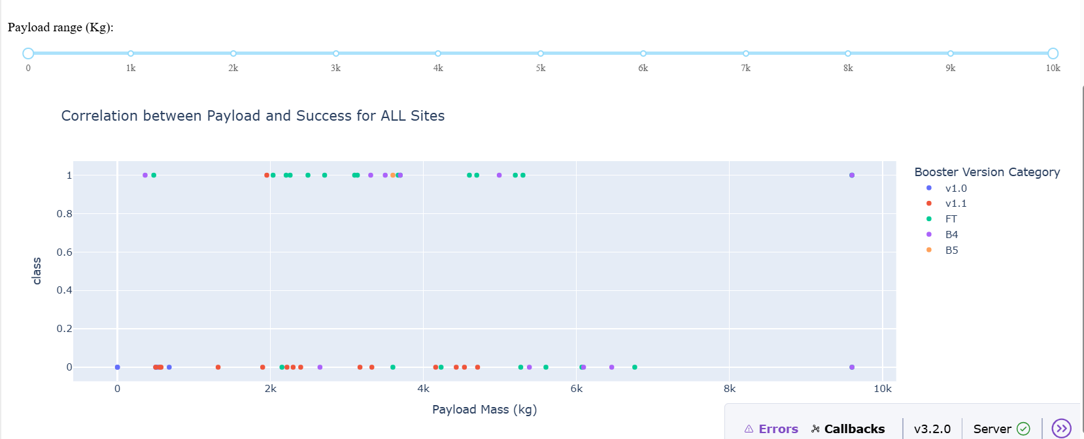
Debra Elkins
Visual Analysis using Plotly & Dash
5. Which F9 Booster version (v1.0, v1.1, FT, B4, B5, etc.) has the highest launch success rate?
ANSWER:
FT has 13 successful launches to 6 failures = 68% success rate

